Slide 1
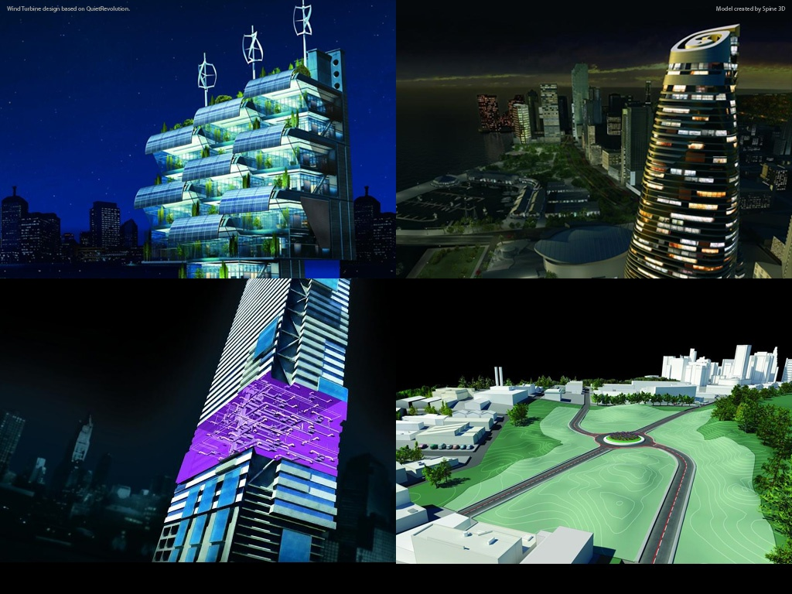
Bridge Design in AutoCAD Civil 3D
Tony Huang
SWD
Civil 3D
Notes:
AEC Title

Slide 2
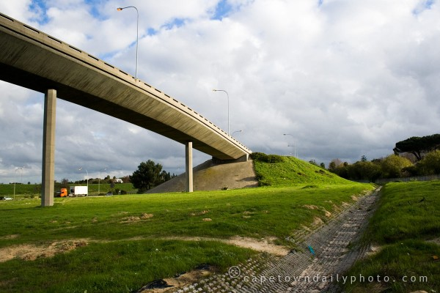
Background
Disability of Civil 3D for Bridge Design
Notes:
Civil3D can’t solve problem of designing bridge. But Civil3D is good at modeling the road. Why not use Civil3D to model some bridges which are similar to the roads?

Slide 3
Agenda
Bridge types & scope
How to design a bridge?
What can Civil3D do in the bridge designing?
Work Flow of Modeling
Alignment & Profile
Assembly (Bridge Section & Road Section)
Corridor
Intersection
Supports
Foundation
Structure Analysis
RSA, RST & ASD
Others
Drawings & Reports
Notes:
As the Civil3D is good at modeling, this ppt’s focus will be in work flow of bridge modeling.

Slide 4
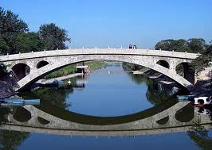
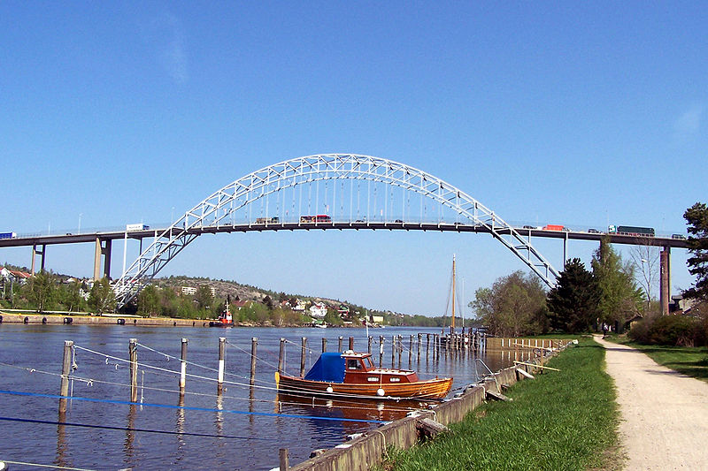
Bridge Types & Scope
Arch Bridge
Suspension Bridge
Cable-stayed Bridge
Continuous Beam Bridge
Notes:
Arch Bridge: An arch bridge is a bridge with abutments at each end shaped as a curved arch. Arch bridges work by transferring the weight of the bridge and its loads partially into a horizontal thrust restrained by the abutments at either side. A viaduct (a long bridge) may be made from a series of arches, although other more economical structures are typically used today.
Zhaozhouqiao Bridge, Fredrikstad Bridge Norway

Slide 5
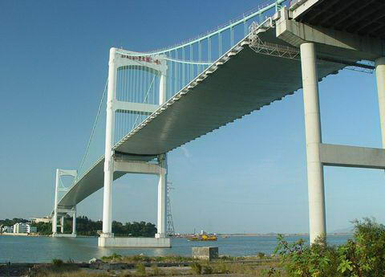

Bridge Types & Scope
Arch Bridge
Suspension Bridge
Cable-stayed Bridge
Continuous Beam Bridge
Notes:
Suspension Bridge: A suspension bridge is a type of bridge in which the deck (the load-bearing portion) is hung below suspension cables on vertical suspenders.
Shantou Bridge, Bosphorus Bridge in Istanbul

Slide 6
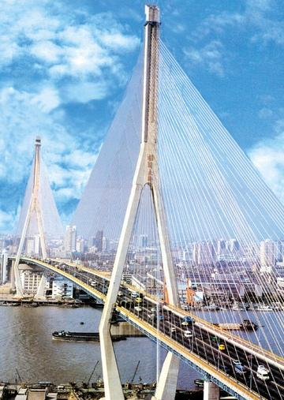

Bridge Types & Scope
Arch Bridge
Suspension Bridge
Cable-stayed Bridge
Continuous Beam Bridge
Notes:
Cable-stayed Bridge: A cable-stayed bridge is a bridge that consists of one or more columns (normally referred to as towers or pylons), with cables supporting the bridge deck.
Yangpu Bridge, Rama VIII Bridge

Slide 7
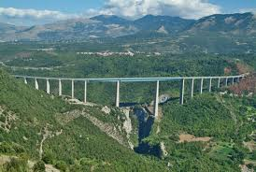
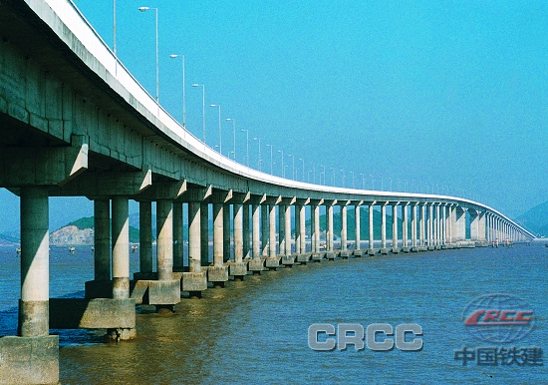
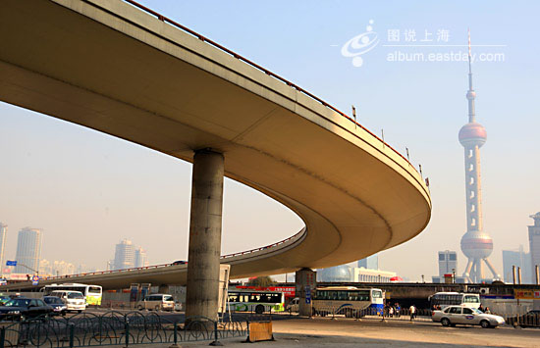
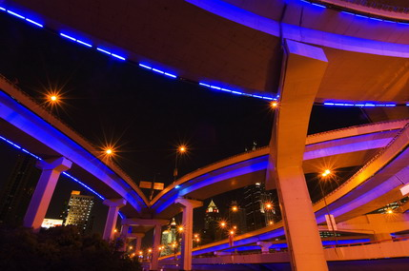
Bridge Types & Scope
Arch Bridge
Suspension Bridge
Cable-stayed Bridge
Continuous Truss Bridge
------ Scope
Notes:
Continuous Truss Bridge: A continuous truss bridge is a truss bridge which extends without hinges or joints across three or more supports. A continuous truss bridge may use less material than a series of simple trusses because a continuous truss distributes live loads across all the spans; in a series of simple trusses, each truss must be capable of supporting the entire load.
To design a continuous truss bridge is our scope.
Another point I have to say, the working way between road engineer and bridge engineer has changed.
In the old way, bridge engineer determine the location where building a bridge first, and then road engineer design a road to adapt to the bridge. (Sometime this way is still used, when designing the especially large bridge.)
But now, more and more is design road at the first, and then set up bridge. It is in order to enhance driving comfort and security. (And not to put saving the construction cost in the first place.)
On the other hand, building more and more highway, also need to build more elevated bridge. In China, most of the highway are the closed elevated bridge.

Slide 8
How to design a bridge?
Conceptual design
Both model type and structure type of bridge will be selected and coarse bridge model will be designed for prototype.
Modeling and structure analysis, redesign
Including load-bearing, material, aseismic and anti-wind analysis, etc. Based on these analysis results, designers will refine the model and get accurate design ready for construction. The final design comes out with several iterations.
Construction & project reports
Calculating prestressed reinforced and reinforced of every structures. Make the construction process management plan. Submit the drawings and the project reports.
Notes:
Conceptual design
Both model type and structure type of bridge will be selected and coarse bridge model will be designed for prototype.
Modeling and structure analysis, redesign
Including load-bearing, material, aseismic and anti-wind analysis, etc. Based on these analysis results, designers will refine the model and get accurate design ready for construction. The final design comes out with several iterations.
Construction & project reports
Calculating prestressed reinforced and reinforced of every structures. Make the construction process management plan. Submit the drawings and the project reports.

Slide 9
Civil3D
Modeling
Structure
Analysis
(RSA)
(RST)
(ASD)
Work Flow
Alignment
Design conditions
Profile
Gravity load
Wind load
Shock
Brake load
Assembly
Mechanics
SAC
Bridge
Section
Compressive
Road
Section
Bending
Shearing
Corridor
Material
Steel
Foundation design
Intersection
Reinforced concrete
...
Supports
...
Prestressed concrete
...
Foundation
...
Drawings & Reports
Notes:
Most of the work flow are the same as road designing. In the left picture, the yellow parts are newly added. When designing the assembly, we will design the bridge section and the road section. We can easily create section of the bridge by using the Subassembly Composer.
After building the corridor and design the intersection, we need to design the bridge supports and the foundation.
And these several parts will influence each other. If increase the distance between the supports, the bridge section will be higher, the foundation may also be bigger and deeper. And the size of these assemblies are depend on the a lot of conditions, something like the design conditions, the mechanics, the material of the bridge, etc. And all of these conditions will be analysis by the structure analysis software, as RSA, RST, ASD, or other company's professional bridge software.
Based on the analysis results, designers will refine the model and get accurate design ready for construction. The final design comes out with several iterations.
RSA : Autodesk Robot Structural Analysis Professional
RST : Autodesk Revit Structure
ASD : AutoCAD Structural Detailing

Slide 10
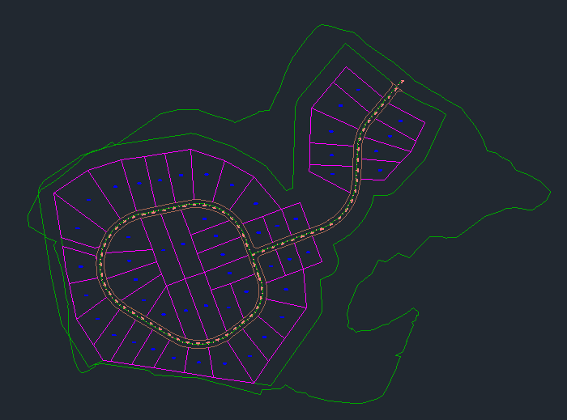
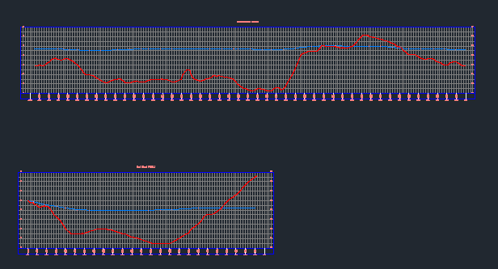
Alignment
Profile
Notes:
First of all, the designer need to design an alignment and profile as designing a normal road. But the profile can be separated from the ground, and it will be more gently.

Slide 11
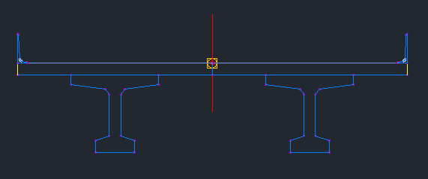
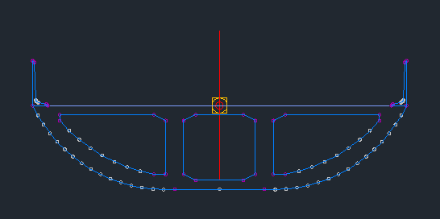
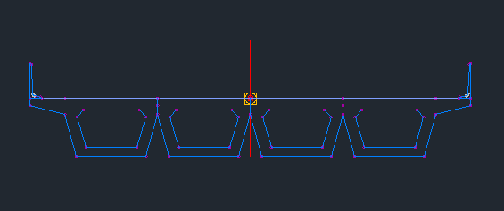
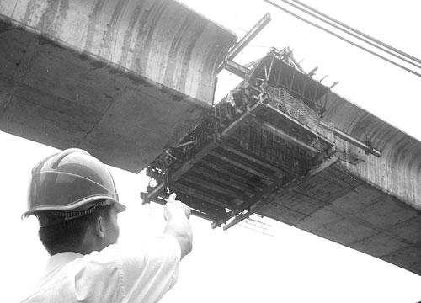
Assembly
Bridge
Section
Notes:
Here are some types of the bridge sections.
The first one is a independent box-grider while has both arc sides. This type are usually used in city, because its modeling beautiful.
The second one is a I-Beam. The material of this one is concrete, and some of I-Beam are steel. The coverage in the above of I-Beam is the concrete slab.
The last one is an other type of box-grider, which is made up by many boxes. And these can be made in the factory, and then transported to the location and installing.
By the way, in the section, the balustrades are indispensable.

Slide 12
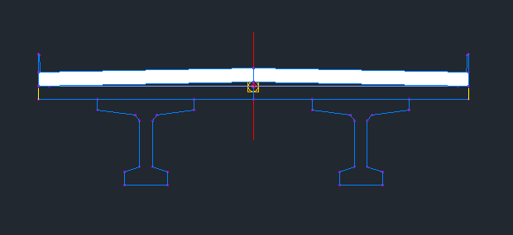
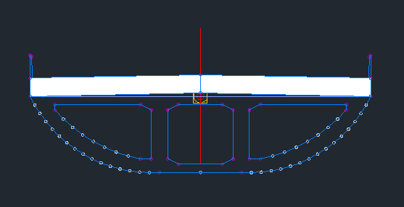
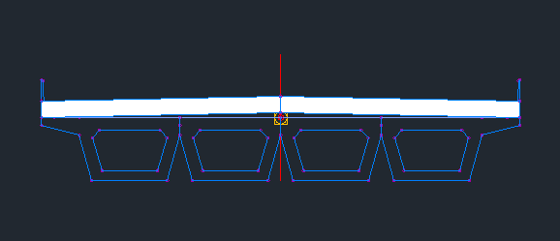
Assembly
Road
Section
Notes:
And then add the road section on the top of the bridge section. And it is simple than the normal road designing, because don't need to design Shoulders, Daylight.

Slide 13
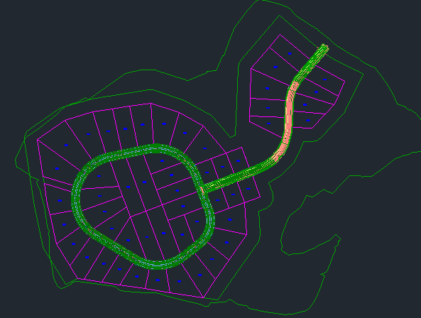
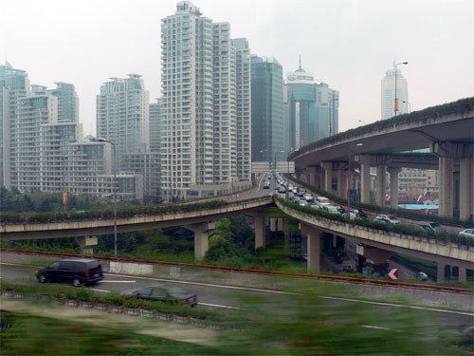
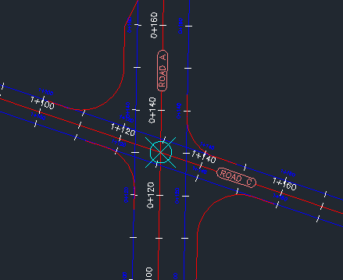
Corridor
Intersection

Slide 14
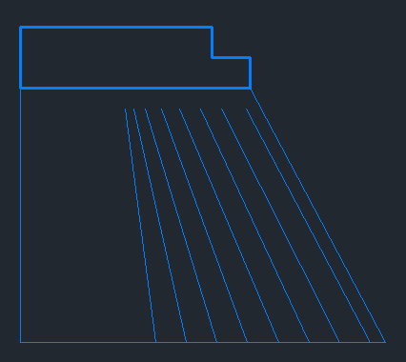
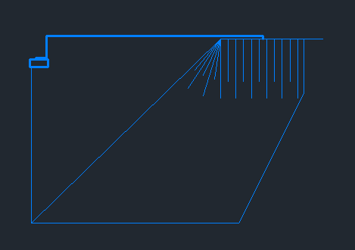
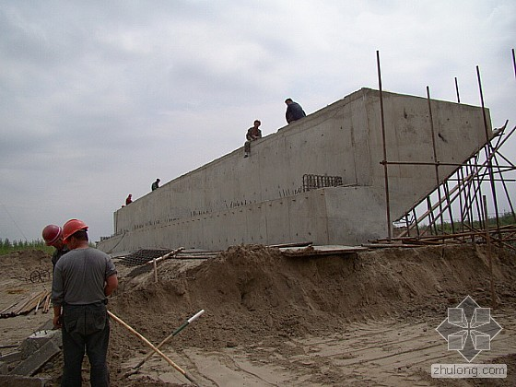
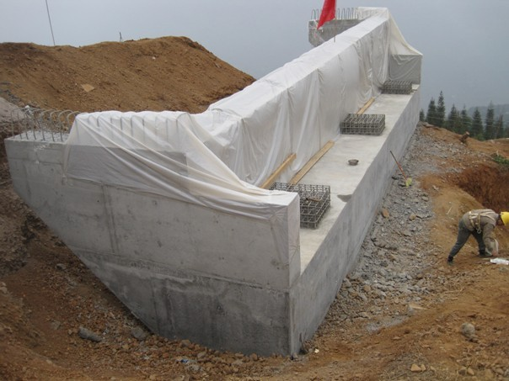
Supports

Slide 15
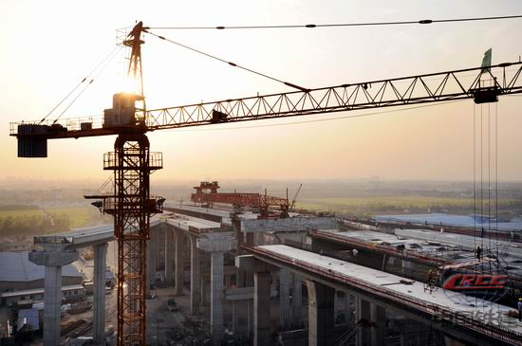
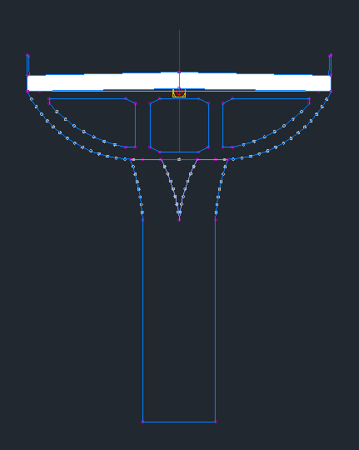
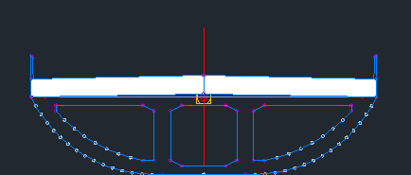
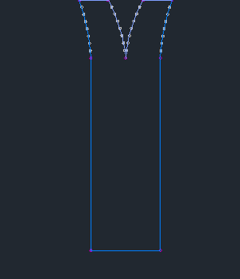
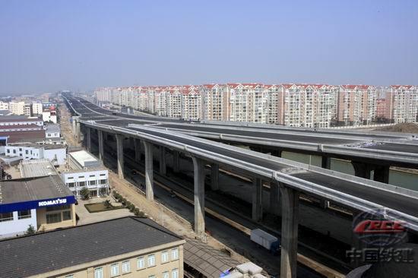
Supports

Slide 16
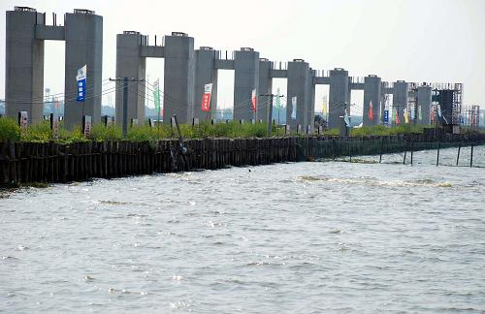
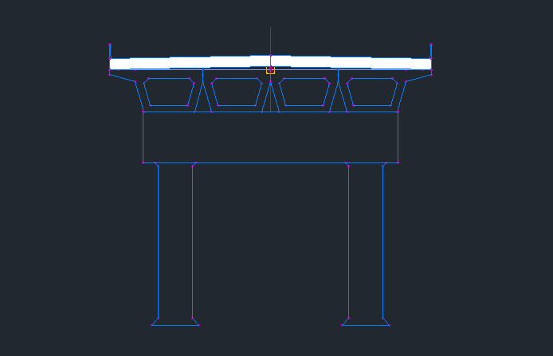

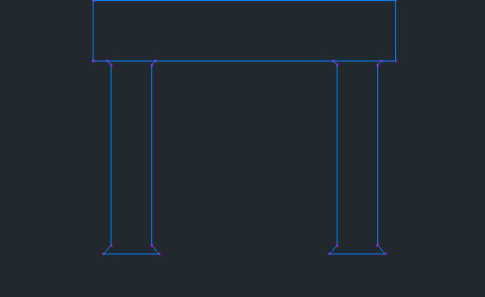
Supports

Slide 17
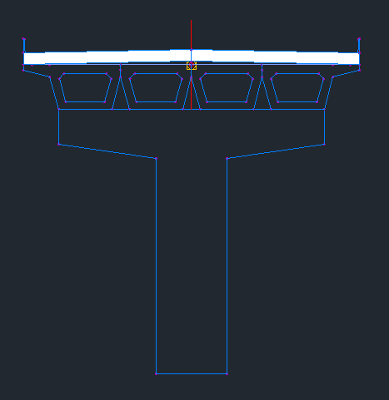
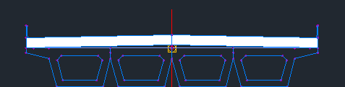
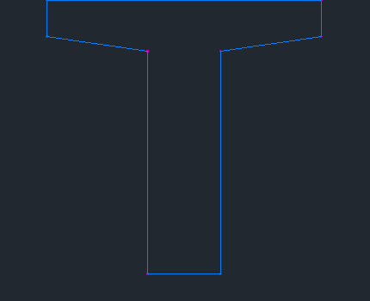
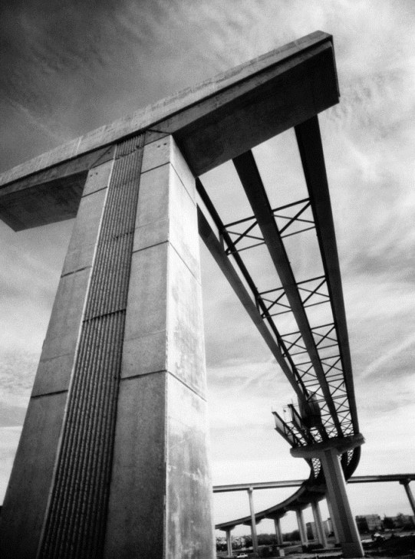
Supports

Slide 18
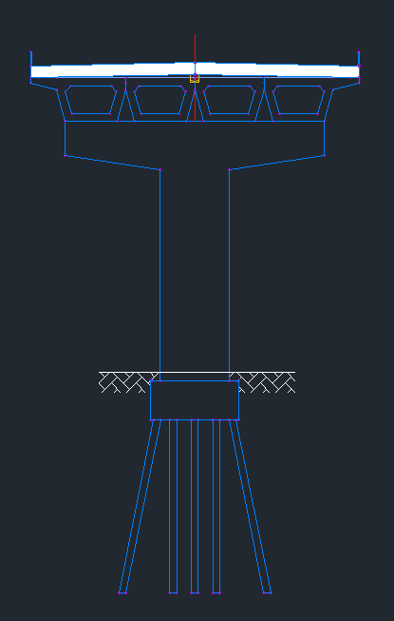
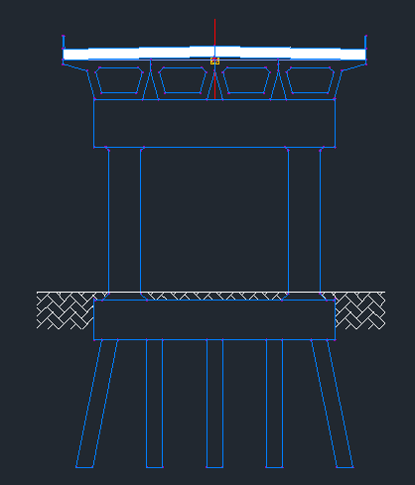
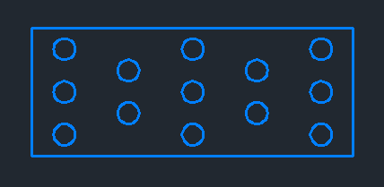
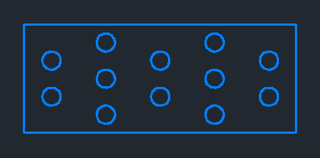
Foundation

Slide 19
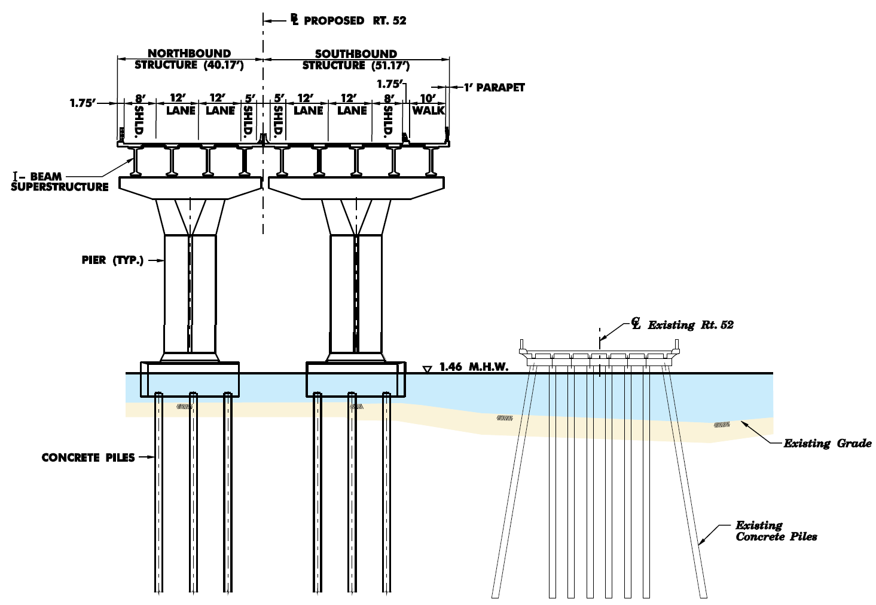
Overview

Slide 20
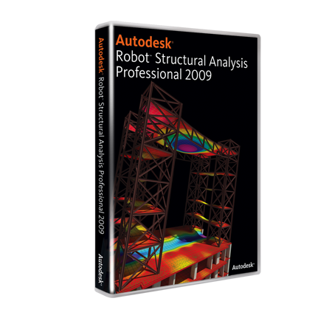
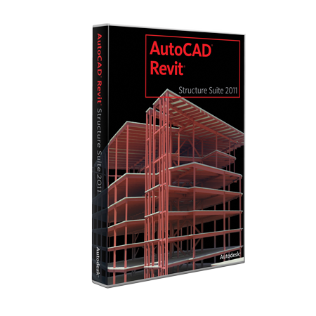

Structure
Analysis
Notes:
RSA : Autodesk Robot Structural Analysis Professional
RST : Autodesk Revit Structure
ASD : AutoCAD Structural Detailing
If necessary, we can provide the interface, and output the 3d model of the bridge. So that some other Finite Element Analysis software (as the Midas Bridge) can use the model to do the structure analysis. In this way, the bridge engineer will not change the existing Usage and Attitude. And our software easier to promotion.

Slide 21
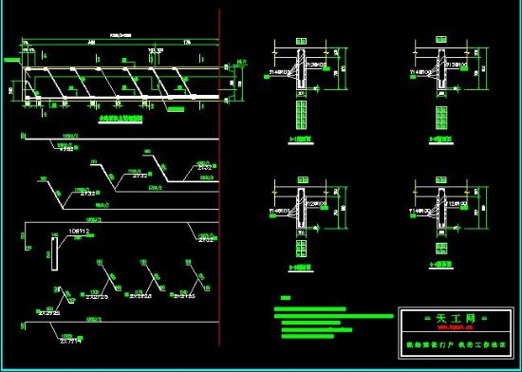
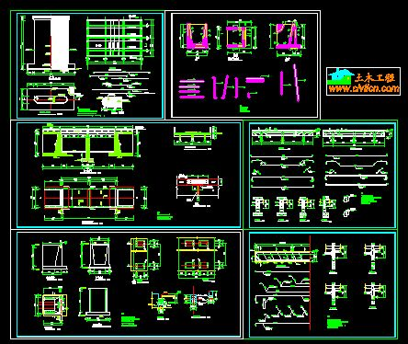
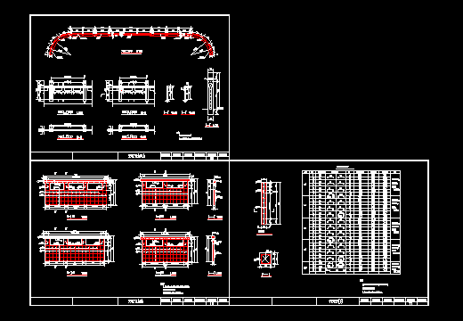
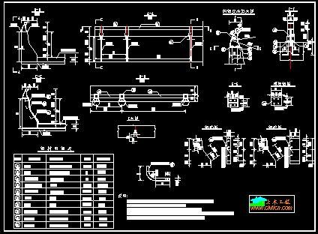
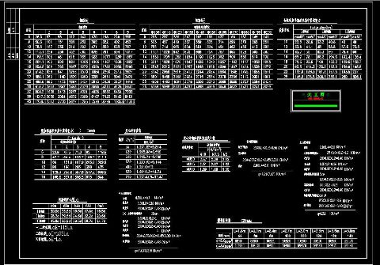

Drawings
Reports

Slide 22
Civil3D
Modeling
Structure
Analysis
(RSA)
(RST)
(ASD)
Work Flow
Alignment
Design conditions
Profile
Gravity load
Wind load
Shock
Brake load
Assembly
Mechanics
SAC
Bridge
Section
Compressive
Road
Section
Bending
Shearing
Corridor
Material
Steel
Foundation design
Intersection
Reinforced concrete
...
Supports
...
Prestressed concrete
...
Foundation
...
Drawings & Reports

Slide 23
Q & A

